Slide 1
Python Control Flow

Slide 2
What is control flow?
Control flow is the order in which individual statements, instructions, or function calls are executed or evaluated.
The control flow of a Python program is regulated by conditional statements, loops, and function calls.

Slide 3
Python if...else Statement
In computer programming, we use the if statement to run a block code only when a certain condition is met.
For example, assigning grades (A, B, C) based on marks obtained by a student.
  if the percentage is above 90, assign grade A
  if the percentage is above 75, assign grade B
  if the percentage is above 65, assign grade C
In Python, there are three forms of the if...else statement.
  if statement
  if...else statement
  if...elif...else statement

Slide 4
Python if statement
In computer programming, we use the if statement to run a block code only when a certain condition is met.
For example, assigning grades (A, B, C) based on marks obtained by a student.
  if the percentage is above 90, assign grade A
  if the percentage is above 75, assign grade B
  if the percentage is above 65, assign grade C
In Python, there are three forms of the if...else statement.
  if statement
  if...else statement
  if...elif...else statement

Slide 5
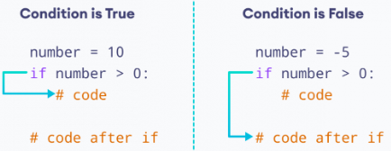
1. Python if statement
The syntax of if statement in Python is:
  if condition:
  # body of if statement
The if statement evaluates condition.
  If condition is evaluated to True, the code inside the body of if is executed.
  If condition is evaluated to False, the code inside the body of if is skipped.
Working of if Statement

Slide 6
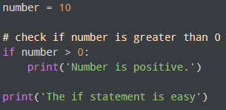
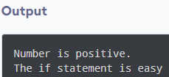
Example 1: Python if Statement
In the above example, we have created a variable named number. Notice the test condition,
number > 0
Here, since number is greater than 0, the condition evaluates True.
If we change the value of variable to a negative integer. Let's say -5.
  number = -5
Now, when we run the program, the output will be:
  The if statement is easy
This is because the value of number is less than 0. Hence, the condition evaluates to False. And, the body of if block is skipped.

Slide 7
2. Python if...else Statement
An if statement can have an optional else clause.
The syntax of if...else statement is:
  if condition:
  # block of code if condition is True
  else:
  # block of code if condition is False
The if...else statement evaluates the given condition:
If the condition evaluates to True,
  the code inside if is executed
  the code inside else is skipped
If the condition evaluates to False,
  the code inside else is executed
  the code inside if is skipped

Slide 8
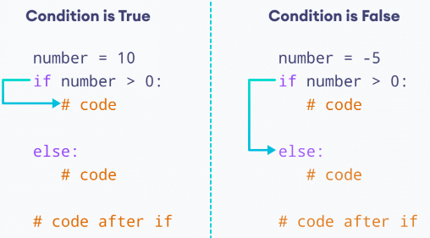
Working of if...else Statement

Slide 9
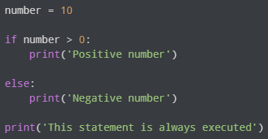
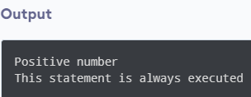
Example 2. Python if...else Statement
In the above example, we have created a variable named number. Notice the test condition,
number > 0
Since the value of number is 10, the test condition evaluates to True. Hence code inside the body of if is executed.
If we change the value of variable to a negative integer. Let's say -5.
number = -5
Now if we run the program, the output will be:
Number is negative. This statement is always executed.
Here, the test condition evaluates to False. Hence code inside the body of else is executed.

Slide 10
3. Python if...elif...else Statement
The if...else statement is used to execute a block of code among two alternatives.
However, if we need to make a choice between more than two alternatives, then we use the if...elif...else statement.
The syntax of the if...elif...else statement is:
  if condition1:
  # code block 1
  elif condition2:
  # code block 2
  else:
  # code block 3
Here,
  If condition1 evaluates to true, code block 1 is executed.
  If condition1 evaluates to false, then condition2 is evaluated.
  If condition2 is true, code block 2 is executed.
  If condition2 is false, code block 3 is executed.

Slide 11
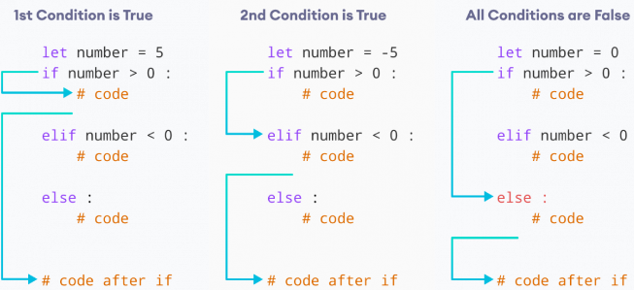
Working of if...elif Statement

Slide 12
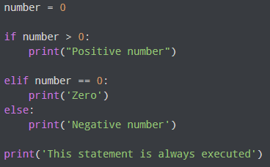
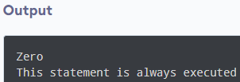
Example 3: Python if...elif...else Statement
In the above example, we have created a variable named number with the value 0. Here, we have two condition expressions:
Here, both the conditions evaluate to False. Hence the statement inside the body of else is executed.

Slide 13
Python Nested if statements
We can also use an if statement inside of an if statement. This is known as a nested if statement.
The syntax of nested if statement is:
  # outer if statement
  if condition1:
  # statement(s)
  # inner if statement
  if condition2:
  # statement(s)
Notes:
  We can add else and elif statements to the inner if statement as required.
  We can also insert inner if statement inside the outer else or elif statements(if they exist)
  We can nest multiple layers of if statements

Slide 14
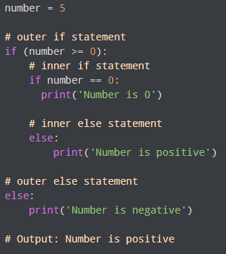
Example 4: Python Nested if Statement
In the above example, we have used a nested if statement to check whether the given number is positive, negative, or 0.

Slide 15
Loops in Python
In computer programming, loops are used to repeat a block of code.
For example, if we want to show a message 100 times, then we can use a loop. It's just a simple example; you can achieve much more with loops.
There are 2 types of loops in Python:
  for loop
  while loop

Slide 16
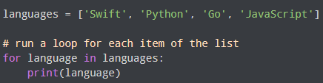
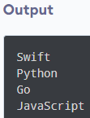
Python for Loop
In Python, a for loop is used to iterate over sequences such as lists, tuples, string, etc. For example,
In the above example, we have created a list called languages.
Initially, the value of language is set to the first element of the array, i.e. Swift, so the print statement inside the loop is executed.
language is updated with the next element of the list, and the print statement is executed again. This way, the loop runs until the last element of the list is accessed.

Slide 17
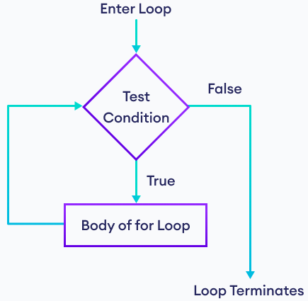


for Loop Syntax
The syntax of a for loop is:
  for val in sequence:
  # statement(s)
Here, val accesses each item of sequence on each iteration. The loop continues until we reach the last item in the sequence.
Example: Loop Through a String
Flowchart of Python for Loop
Working of Python for loop

Slide 18
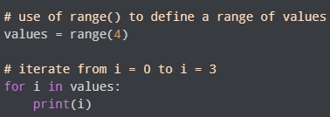

Python for Loop with Python range()
A range is a series of values between two numeric intervals.
We use Python's built-in function range() to define a range of values. For example,
  values = range(4)
Here, 4 inside range() defines a range containing values 0, 1, 2, 3.
In Python, we can use for loop to iterate over a range. For example,

Slide 19
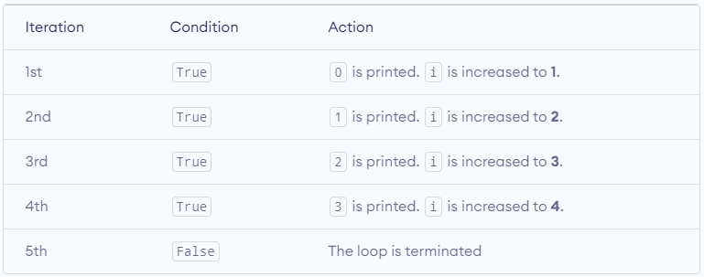
In the above example, we have used the for loop to iterate over a range from 0 to 3.
The value of i is set to 0 and it is updated to the next number of the range on each iteration. This process continues until 3 is reached.

Slide 20
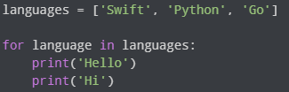

Using a for Loop Without Accessing Items
It is not mandatory to use items of a sequence within a for loop. For example,
Here, the loop runs three times because our list has three items. In each iteration, the loop body prints 'Hello' and 'Hi'. The items of the list are not used within the loop.

Slide 21
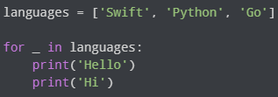
If we do not intend to use items of a sequence within the loop, we can write the loop like this:
The _ symbol is used to denote that the elements of a sequence will not be used within the loop body.

Slide 22
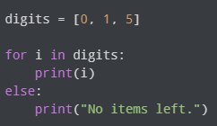
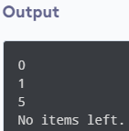
Python for loop with else
A for loop can have an optional else block. The else part is executed when the loop is exhausted (after the loop iterates through every item of a sequence). For example,
Here, the for loop prints all the items of the digits list. When the loop finishes, it executes the else block and prints No items left.
Note: The else block will not execute if the for loop is stopped by a break statement.

Slide 23
Python while Loop
In programming, loops are used to repeat a block of code. For example, if we want to show a message 100 times, then we can use a loop. It's just a simple example, we can achieve much more with loops.
Python while loop is used to run a block code until a certain condition is met.
The syntax of while loop is:
  while condition:
  # body of while loop

Slide 24
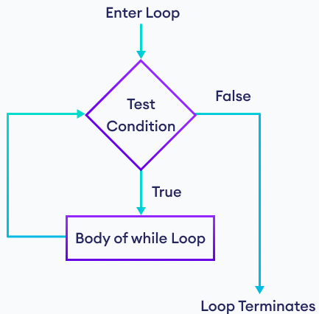
Here,
  A while loop evaluates the condition
  If the condition evaluates to True, the code inside the while loop is executed.
  condition is evaluated again.
  This process continues until the condition is False.
  When condition evaluates to False, the loop stops.
Flowchart of Python while Loop

Slide 25
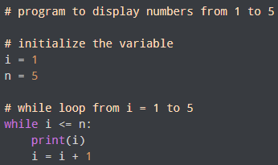

Example: Python while Loop

Slide 26
Here's how the program works:
Variable | Condition: i <= n | Action
i = 1 n = 5 | True | 1 is printed. i is increased to 2.
i = 2 n = 5 | True | 2 is printed. i is increased to 3.
i = 3 n = 5 | True | 3 is printed. i is increased to 4.
i = 4 n = 5 | True | 4 is printed. i is increased to 5.
i = 5 n = 5 | True | 5 is printed. i is increased to 6.
i = 6 n = 5 | False | The loop is terminated.

Slide 27
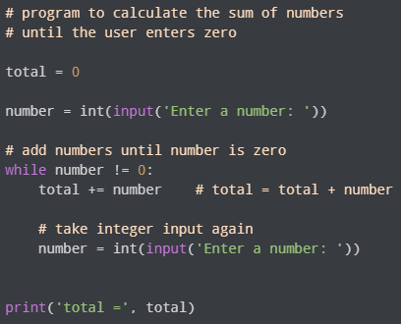
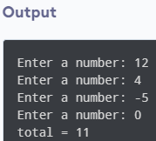
Example 2: Python while Loop
In the above example, the while iterates until the user enters zero. When the user enters zero, the test condition evaluates to False and the loop ends.

Slide 28
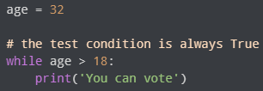
Infinite while Loop in Python
If the condition of a loop is always True, the loop runs for infinite times (until the memory is full). For example,
In the above example, the condition always evaluates to True. Hence, the loop body will run for infinite times.

Slide 29
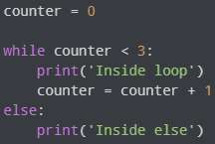
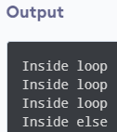
Python While loop with else
In Python, a while loop may have an optional else block.
Here, the else part is executed after the condition of the loop evaluates to False.

Slide 30
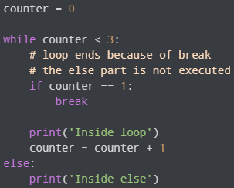
Note: The else block will not execute if the while loop is terminated by a break statement.

Slide 31


Python for Vs while loops
The for loop is usually used when the number of iterations is known. For example,
The while loop is usually used when the number of iterations is unknown. For example,

Slide 32
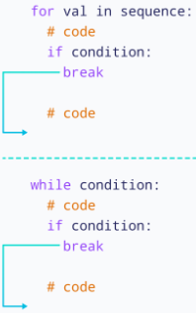
Python break Statement
The break statement is used to terminate the loop immediately when it is encountered.
The syntax of the break statement is: break
The working of break statement in for loop and while loop is shown in the diagram.
Working of the break statement

Slide 33


Python break Statement with for Loop
We can use the break statement with the for loop to terminate the loop when a certain condition is met. For example,
In the above example, we have used the for loop to print the value of i. Notice the use of the break statement,
  if i == 3:
  break
Here, when i is equal to 3, the break statement terminates the loop. Hence, the output doesn't include values after 2.
Note: The break statement is almost always used with decision-making statements.

Slide 34
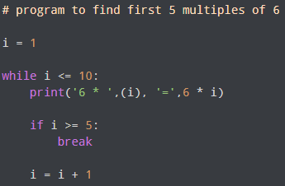
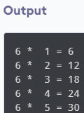
Python break Statement with while Loop
We can also terminate the while loop using the break statement. For example,

Slide 35
In the above example, we have used the while loop to find the first 5 multiples of 6. Here notice the line,
  if i >= 5:
  break
This means when i is greater than or equal to 5, the while loop is terminated.

Slide 36
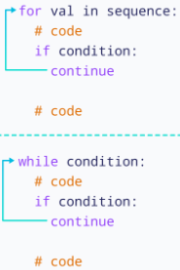
Python continue Statement
The continue statement is used to skip the current iteration of the loop and the control flow of the program goes to the next iteration.
The syntax of the continue statement is: continue
The working of the continue statement in for and while loop is shown in the diagram.
How continue statement works in python

Slide 37


Python continue Statement with for Loop
We can use the continue statement with the for loop to skip the current iteration of the loop. Then the control of the program jumps to the next iteration. For example,
In the above example, we have used the for loop to print the value of i. Notice the use of the continue statement,
  if i == 3:
  continue
Here, when i is equal to 3, the continue statement is executed. Hence, the value 3 is not printed to the output.

Slide 38
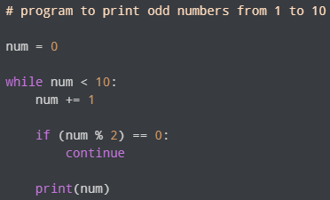

Python continue Statement with while Loop
In Python, we can also skip the current iteration of the while loop using the continue statement. For example,
In the above example, we have used the while loop to print the odd numbers between 1 to 10. Notice the line,
  if (num % 2) == 0:
  continue
Here, when the number is even, the continue statement skips the current iteration and starts the next iteration.

Slide 39
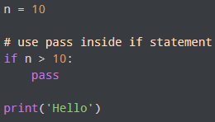
Python pass Statement
In Python programming, the pass statement is a null statement which can be used as a placeholder for future code.
Suppose we have a loop or a function that is not implemented yet, but we want to implement it in the future. In such cases, we can use the pass statement.
The syntax of the pass statement is: pass
Using pass With Conditional Statement
Here, notice that we have used the pass statement inside the if statement.
However, nothing happens when the pass is executed. It results in no operation (NOP).

Slide 40
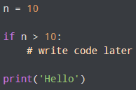
Suppose we didn't use pass or just put a comment as:
Here, we will get an error message: IndentationError: expected an indented block
Note: The difference between a comment and a pass statement in Python is that while the interpreter ignores a comment entirely, pass is not ignored.
Use of pass Statement inside Function or Class
We can do the same thing in an empty function or class as well. For example,
  def function(args):
  pass

